Slide 1
Metro Vision….
Design Thinking: Problem Definition
B711025 김소현
B511074 박준형
B511209 최아성

Slide 2

1. Introduction
Motive?

Slide 3
1. Introduction
Motive?
Issues?
The helpers exist, but not enough.
People might hesitate helping.
GPS limited.
So why don’t we…?

Slide 4
INDEX
1. Introduction
2. Empathy Map
3. Customer Journey Map
4. Idea Relay

Slide 5
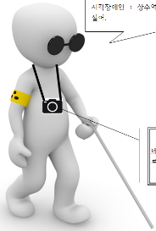
2. Empathy Map
Thinking and Feeling:
“How can I find Exit 1? I’m so overwhelmed…”
Project:
How can we help the visually impaired people take the subway more conveniently?
Client (Persona):
Visually impaired, senior citizens, children
Hear
See
“Hey, out of my way.
I’m busy here!
(annoyed)”
“There are so many people. I can’t find the braille blocks.”
Say and Do
“Excuse me. Would you mind helping me to get to Exit 1? I think I am lost…”
Pain
Gain
Getting lost unexpectedly – overwhelmed, nervous, afraid
“I want to get to Exit 1 as fast and securely as possible.”

Slide 6

?

Slide 7

4. Idea Relay
Q: What technical concepts do we need to build this project?
1. The users won’t be able to see.
Acoustic interface?

Slide 8
4. Idea Relay
Q: What technical concepts do we need to build this project?
1. The users won’t be able to see.
2. We should be able to spot the user precisely.
Acoustic interface?
GPS limit!
AI image recognition?

Slide 9
4. Idea Relay
Q: What technical concepts do we need to build this project?
1. The users won’t be able to see.
2. We should be able to spot the user precisely.
3. How to distinguish the places based on image?
Acoustic interface?
GPS limit!
Implement DB?
AI image recognition?
Sector-distinguished subway map → data map, images
&
Compare with the input

Slide 10
4. Idea Relay
Q: What technical concepts do we need to build this project?
1. The users won’t be able to see.
2. We should be able to spot the user precisely.
3. How to distinguish the places based on image?
4. What if two different places A and B looks the same?
Acoustic interface?
GPS limit!
Implement DB?
Base on
-the data map
-GPS
-the starting point
-path the user has come through
AI image recognition?
Sector-distinguished subway map into the DB → data map
&
Compare with the input

Slide 11
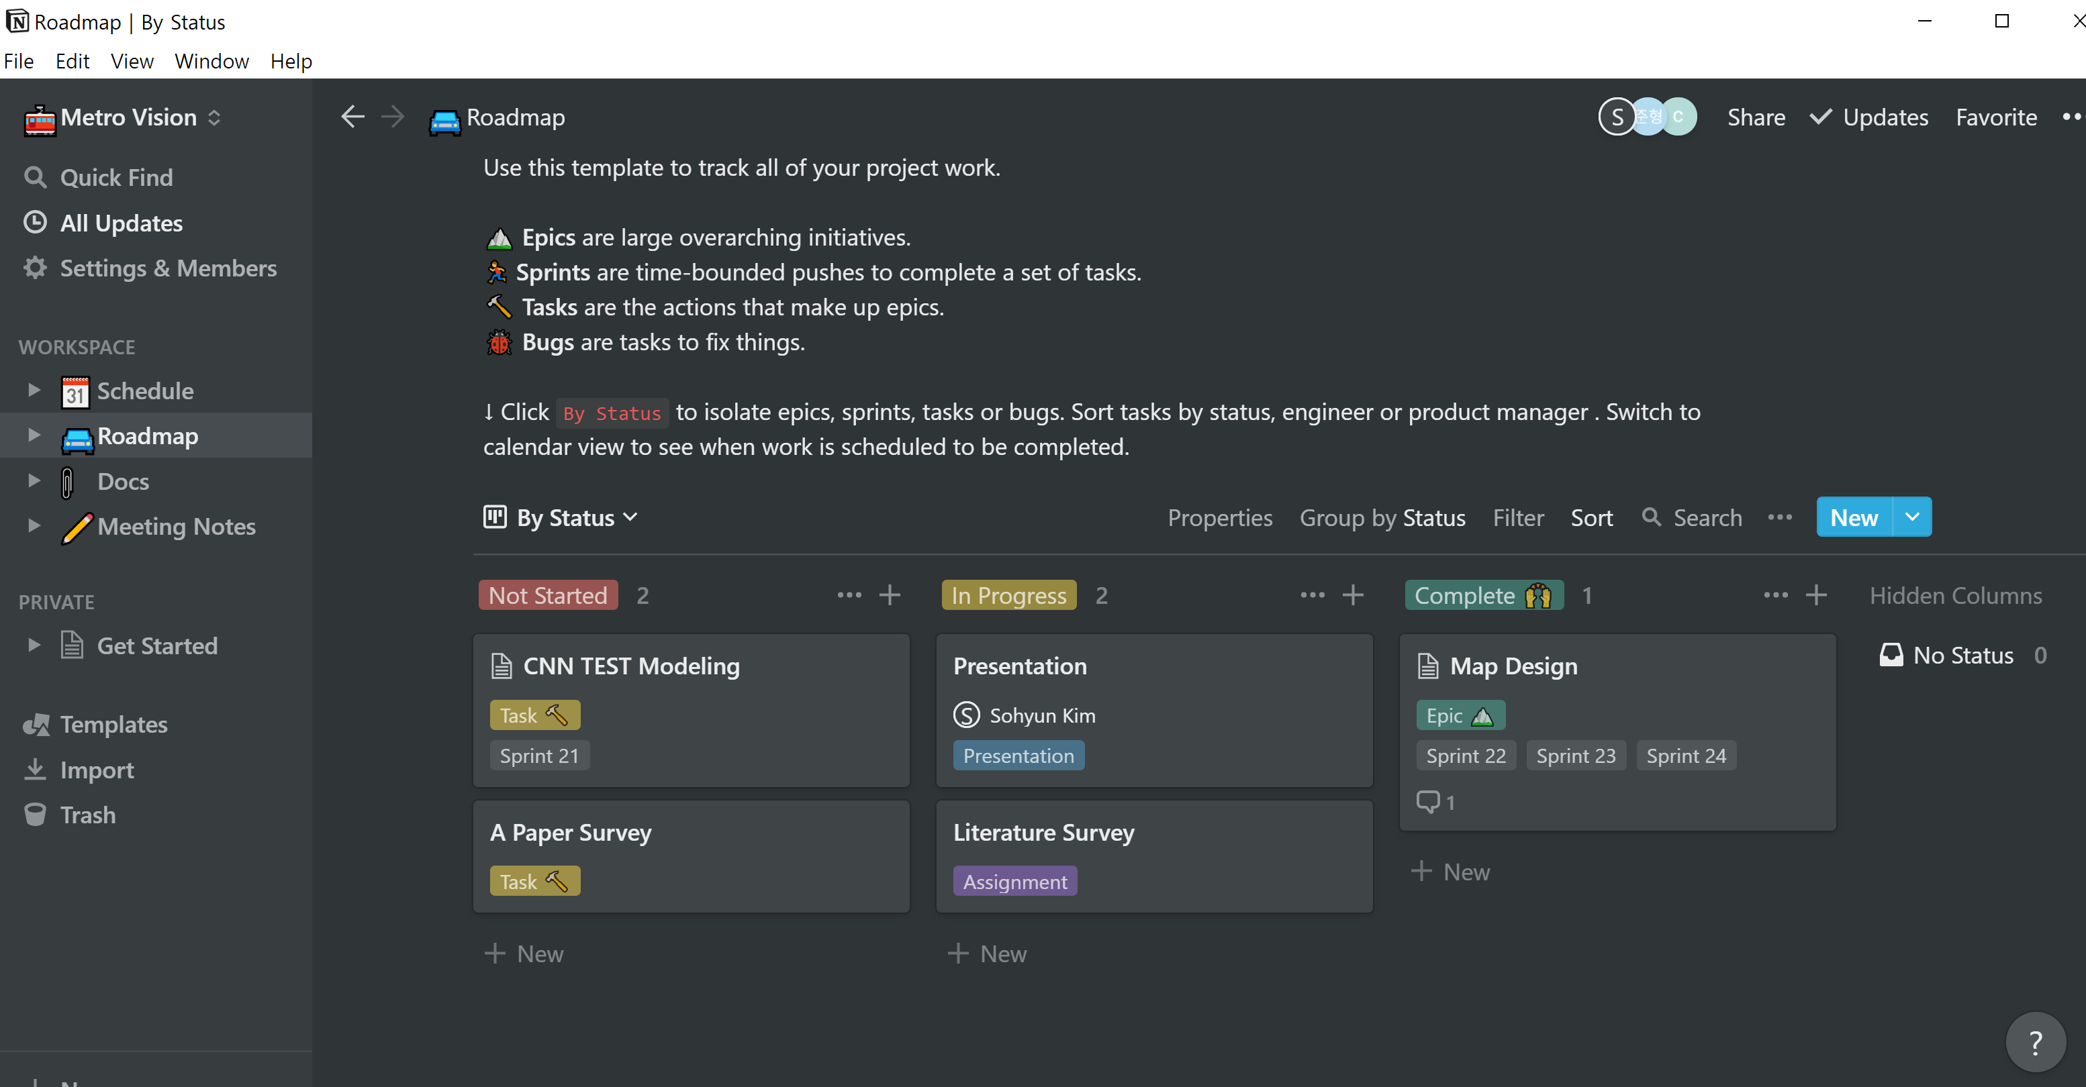
* Notion Setup

Slide 12
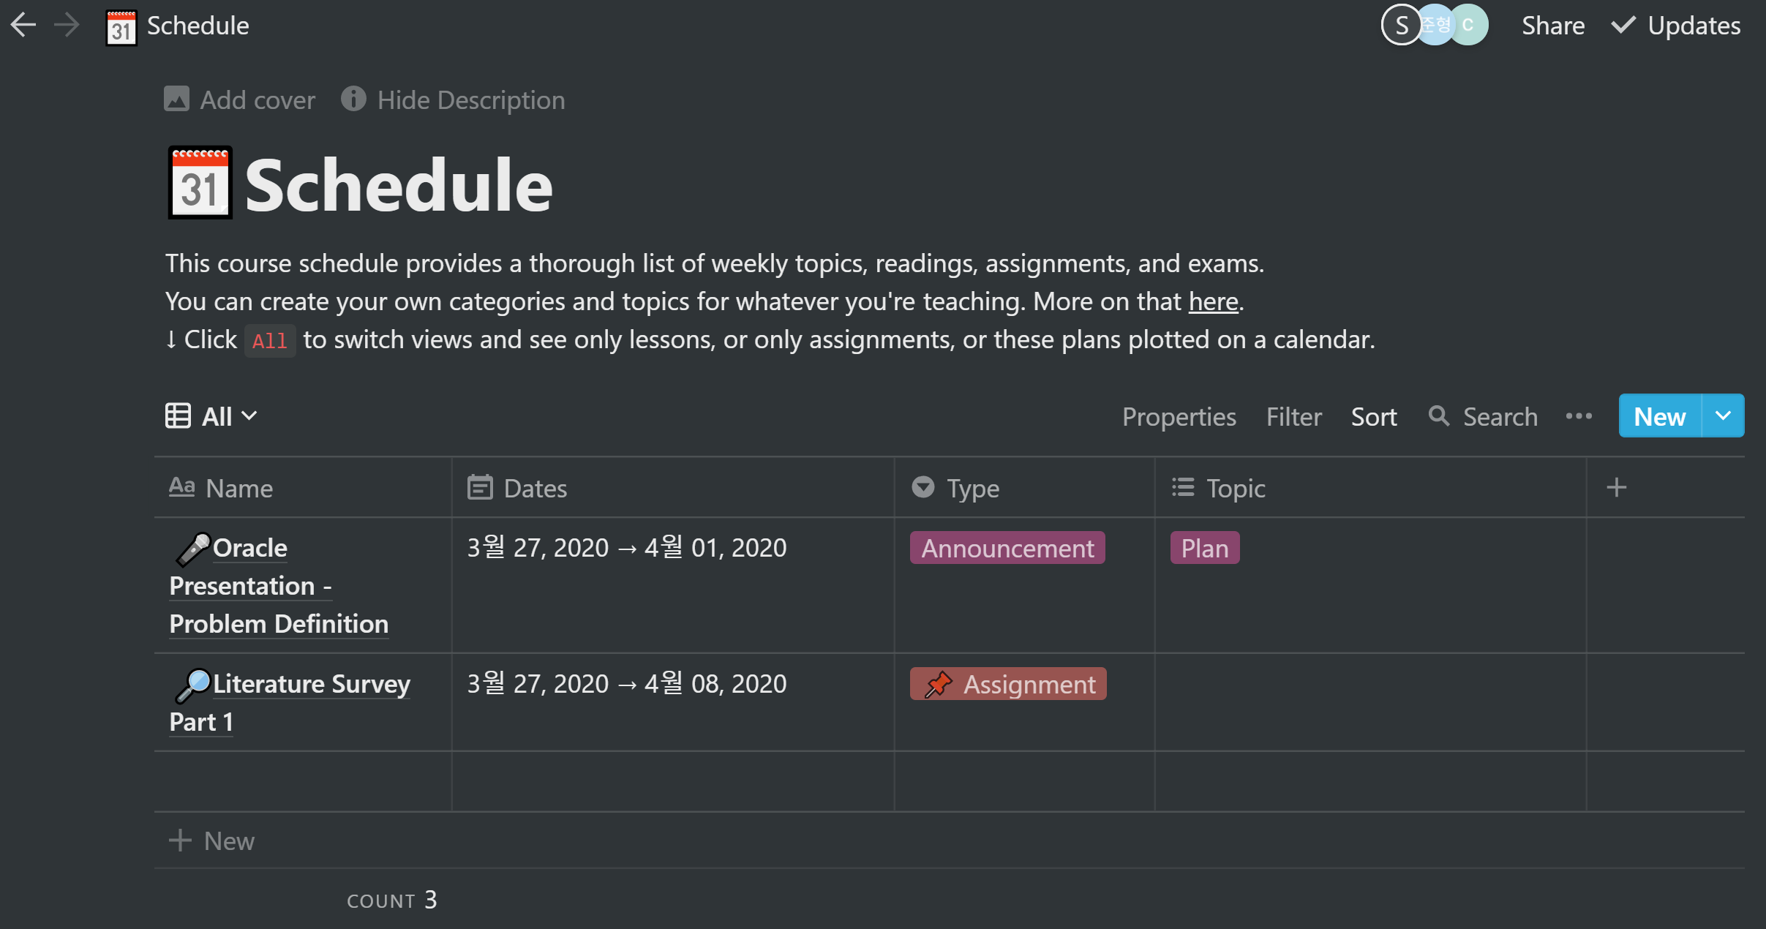
* Notion Setup

Slide 13
Vision….
Thank you.

